Slide 1
WADMIN20-0001
(Mays Building Residential Conversion)
Washoe County Board of Adjustment
April 16, 2020

Slide 2
Request
Conversion of the first floor of an existing commercial office building into two residential apartments. There are six existing residential apartments on the second and third floors of the building. The first floor of the building is 3662 square feet in size.

Slide 3
Overview
Medium Density Urban (MDU) Regulatory Zone
Multi-family dwellings are permissible in the MDU zone with approval of Administrative Permit
Two previous APs:
  Not acted upon in a timely manner
  Substantially different configuration and number of dwellings proposed

Slide 4
Overview
Current request is for two apartments
  3 bedroom, 2 bathroom
  6 bedroom, 3 bathroom
  One covered parking space is required for each dwelling. One additional covered parking space is required to be constructed.

Slide 5
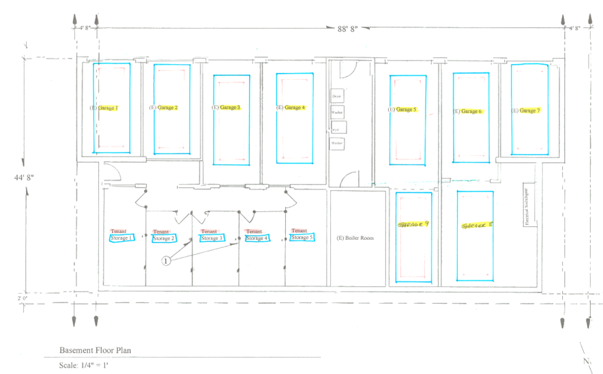
Overview
Applicant seeks BOA approval of existing tandem parking to be determined to be compliant with Code.

Slide 6
Overview
This configuration inhibits access to two garages
Tandem garages are too narrow to be considered a driveway

Slide 7
Overview
Commercial signage must be removed
Exterior light fixtures must be down-shielded
Landscaping and screening will be enhanced to generally comply with Code

Slide 8
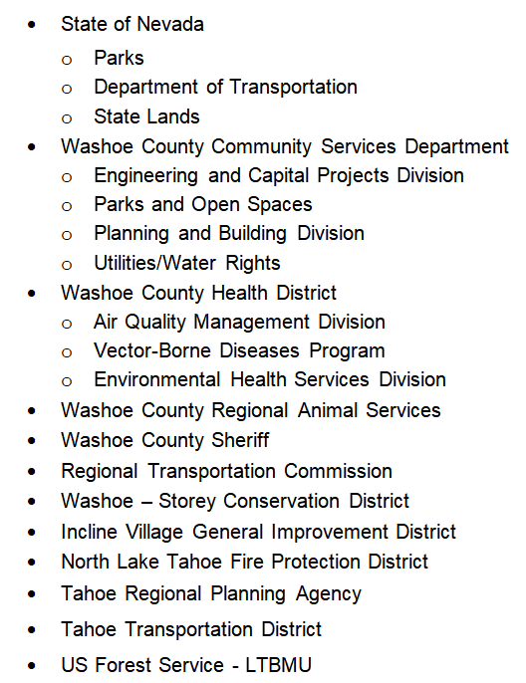
Reviewing
Agencies

Slide 9
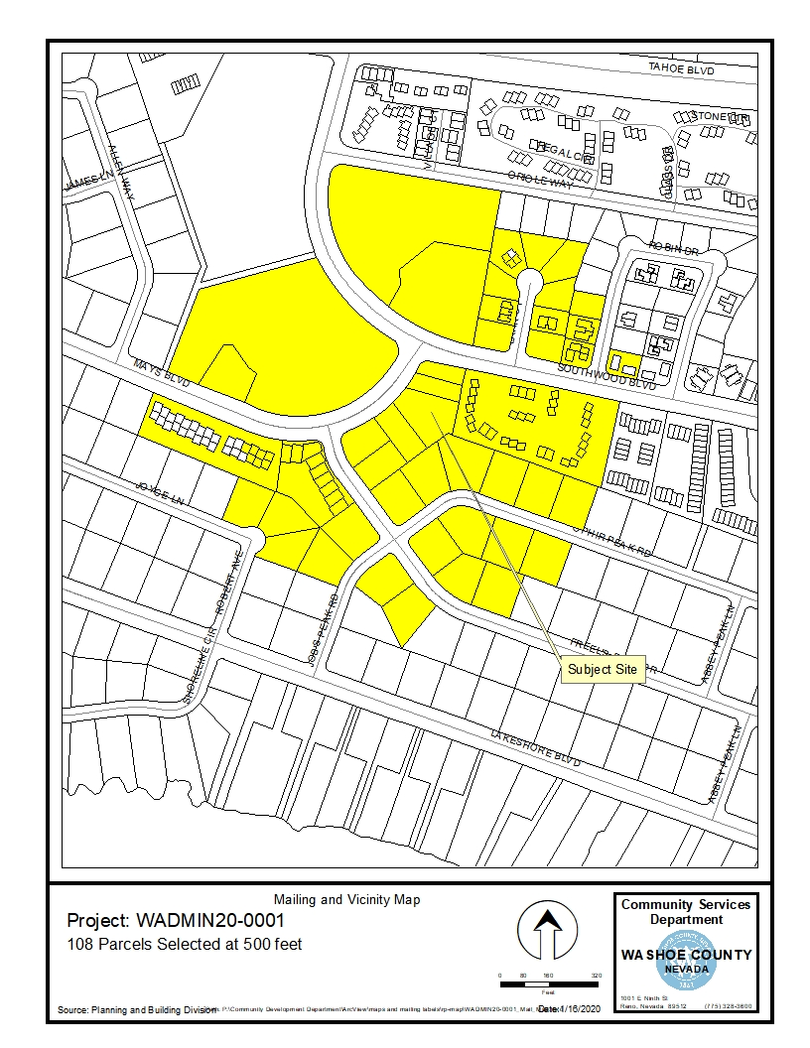
Public Notice & CAB
Notice sent to 108 affected property owners
Incline Village / Crystal Bay CAB met on 2/3/2020.
  Expressed concerns on tandem parking.

Slide 10
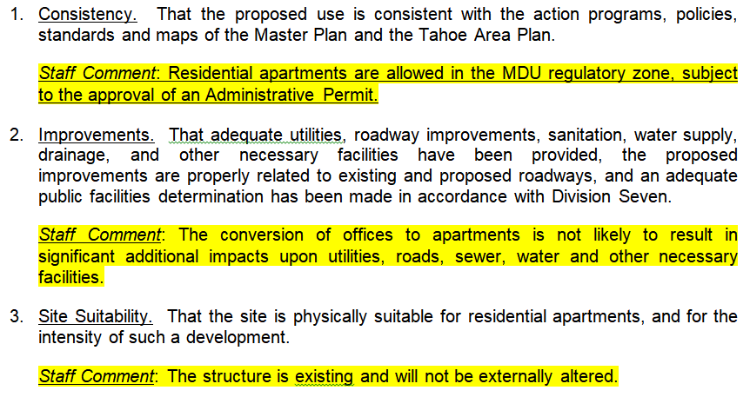
Required Findings

Slide 11
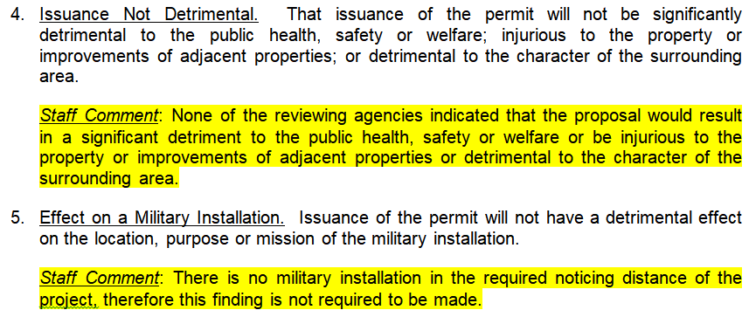
Required Findings

Slide 12
Recommendation
Administrative Permit Case Number WADMIN20-0001 is being recommended for approval with conditions, subject to compliance with generally-applicable Code requirements. Staff offers the following motion for the Board’s consideration.

Slide 13
Possible Motion
I move that, after giving reasoned consideration to the information contained in the staff report and information received during the public hearing, the Board of Adjustment approve Administrative Permit Case Number WADMIN20-0001 for Tim Carlson, SUBJECT TO THE CONDITIONS OF APPROVAL INCLUDED AT ATTACHMENT “A” TO THE STAFF REPROT, having made all required findings in accordance with Washoe County Development Code Section 110.808.25

